Slide 1
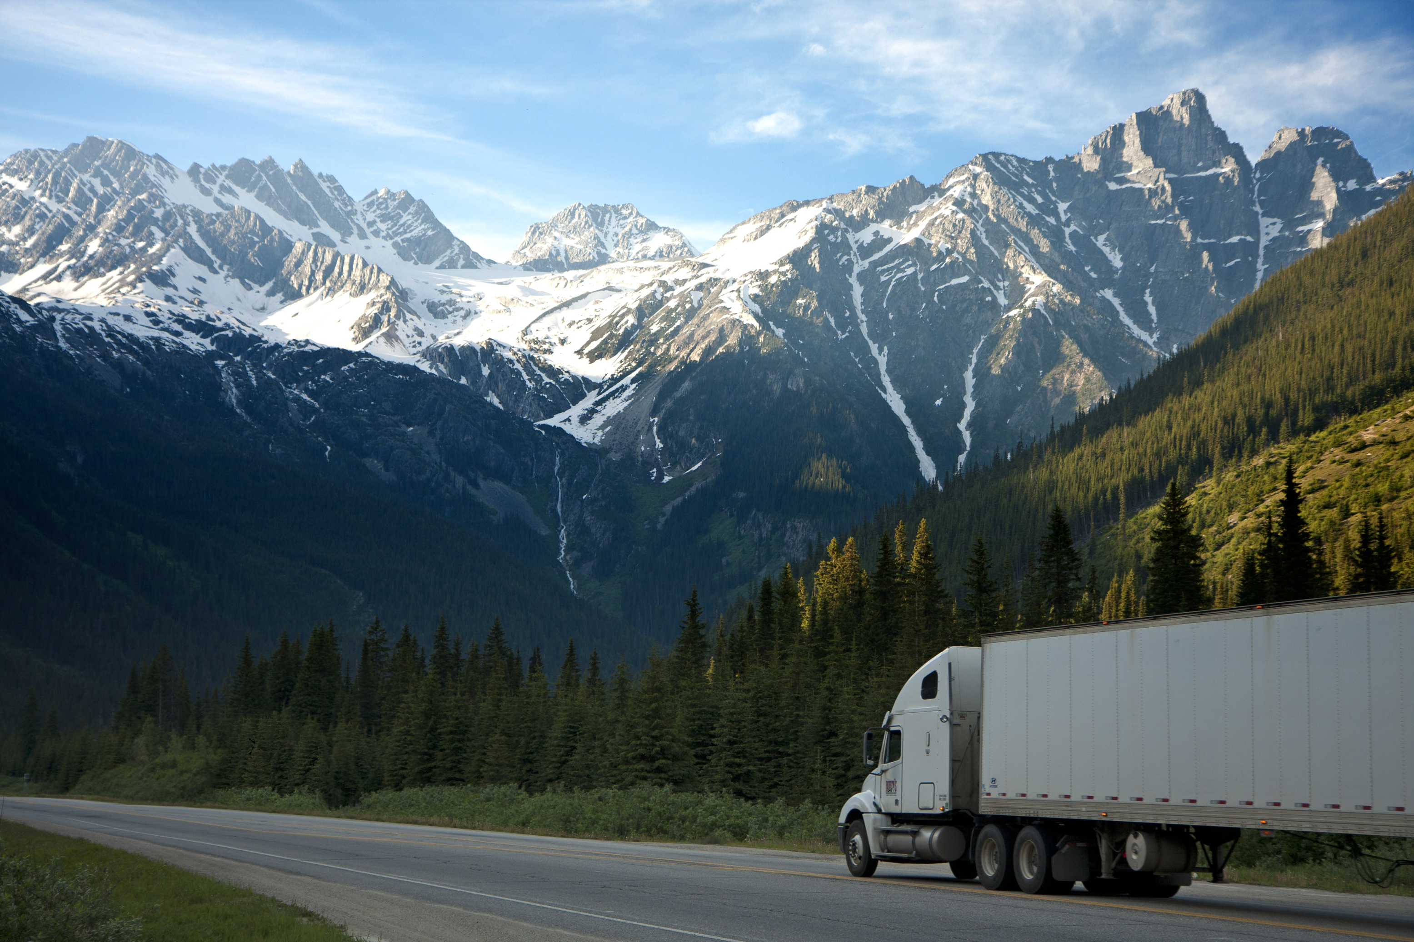
Truck Drivers Risk
Analysis

Slide 2
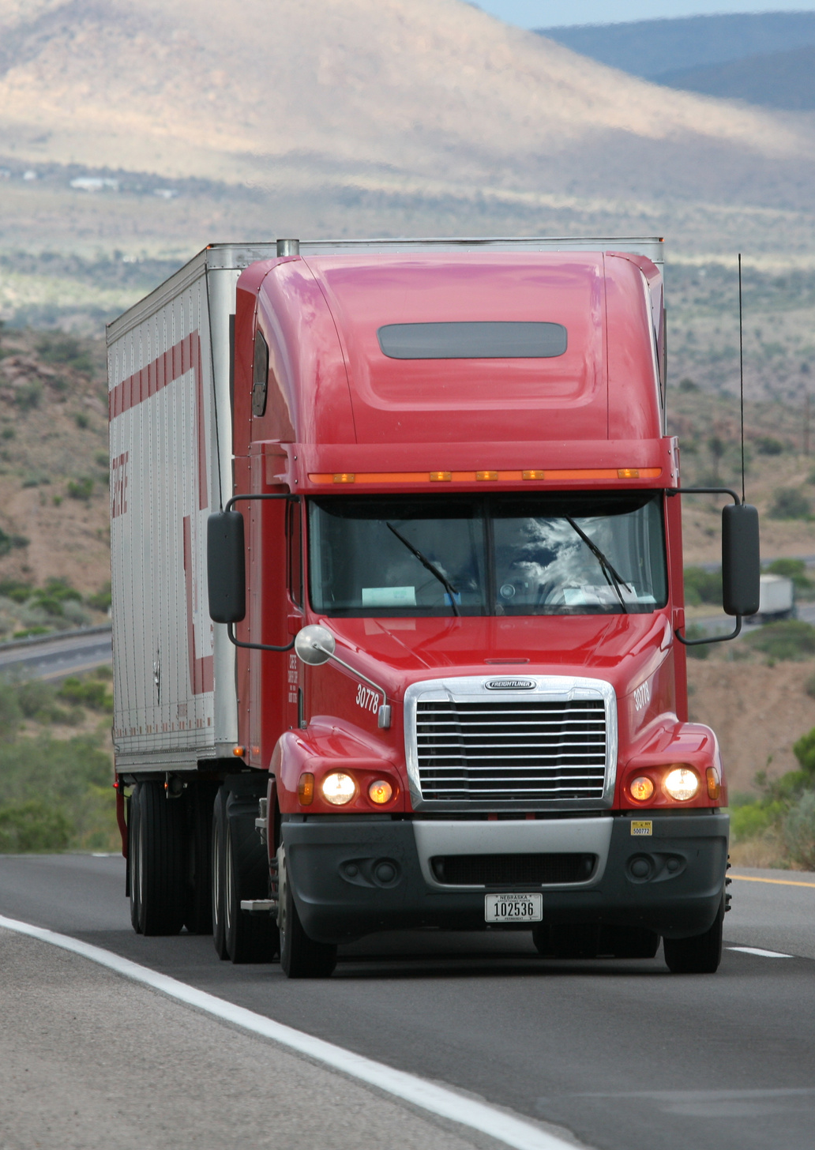
OBJECTIVES
TO ANALYZE DATA AND CREATE DECISION-MAKER REPORTS AND VISUALS USING HADOOP TECHNOLOGIES.
To evaluate location and event instances of each vehicle to enhance truck safety.
IDENTIFY DANGEROUS COMMERCIAL TRUCK DRIVERS ACROSS THE COUNTRY.
To use truck fleet data to improve risk assessment.
PROBLEM STATEMENT
TO IDENTIFY DRIVERS WITH HIGHEST RISK FACTOR IN THE STATE OF CALIFORNIA.
TO IDENTIFY BEST TIME FOR SERVICE BASED ON MILES.
PREDICT THE RISK BASED ON EVENTS AND TOTAL MILES DRIVEN.
TO IDENTIFY THE RISKY TRUCKS USED FOR TRANSPORTATION.

Slide 3






1
Download the dataset and Load the files in cloudera server
2
3
Moving the data files into HDFS
Loading data and Creating tables in HIVE
4
Connection establishment and data modelling in tableau
5
6
Create visualizations in tableau
Predictions and insights
PROCESS FLOW

Slide 4
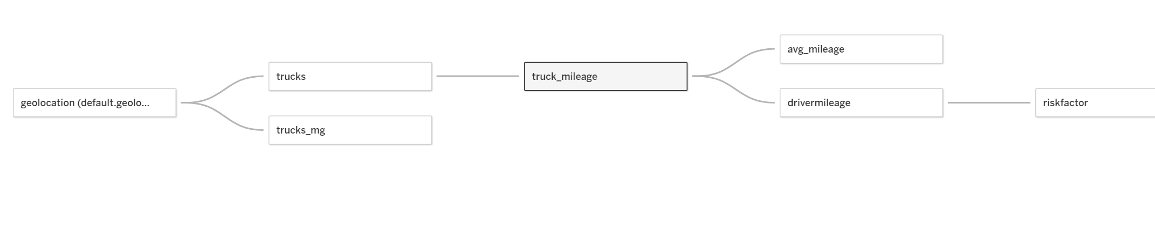
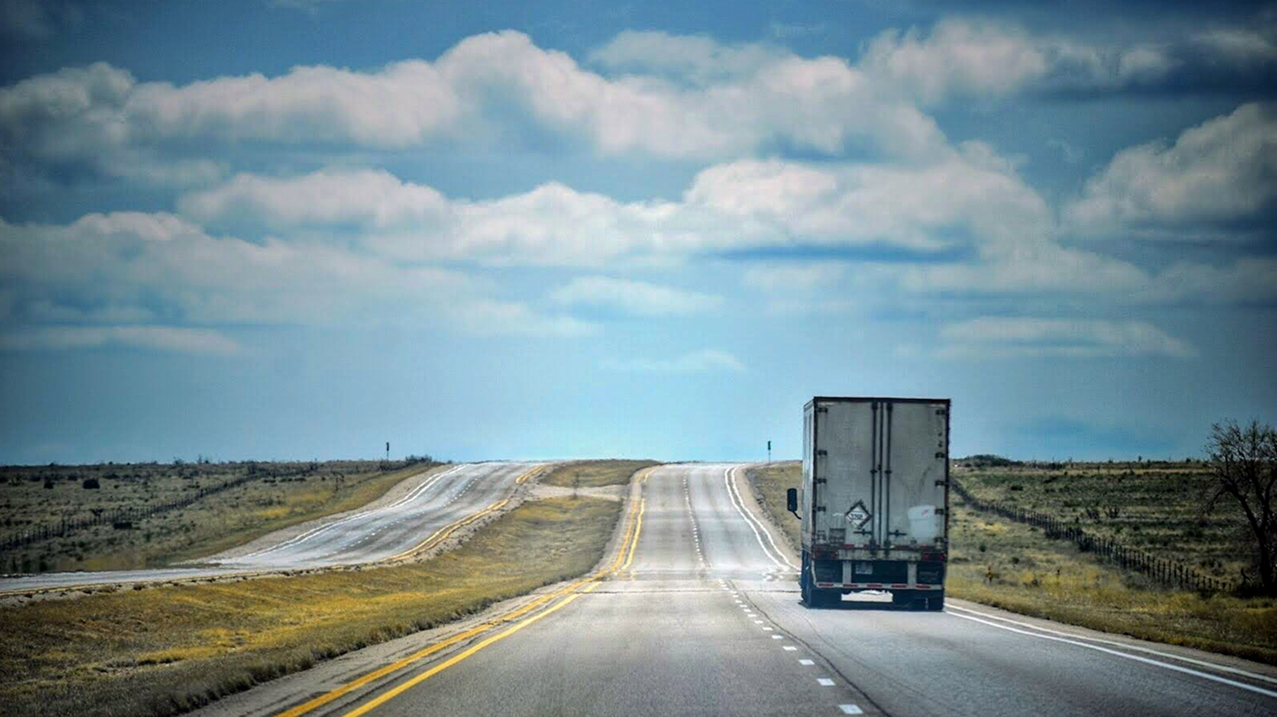
DATA MODELLING

Slide 5
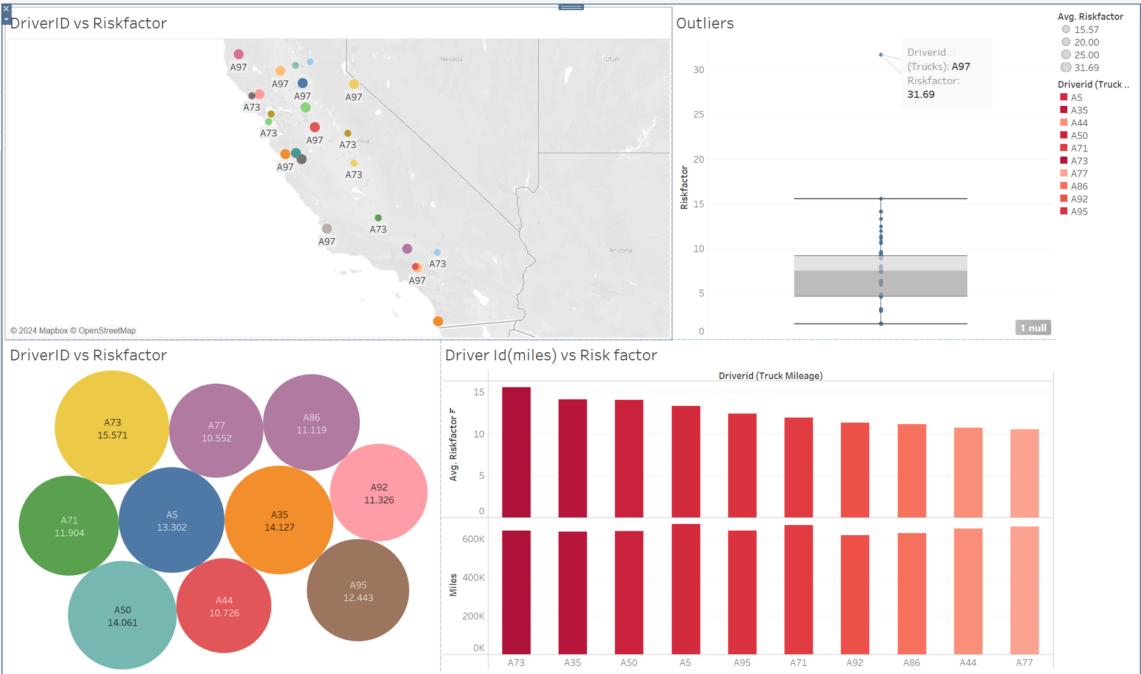
Drivers with Highest Risk Factors
Driver A97 has the highest risk, however based on data it is considered outlier. Northern part of california has more drivers with higher risk factors.

Slide 6
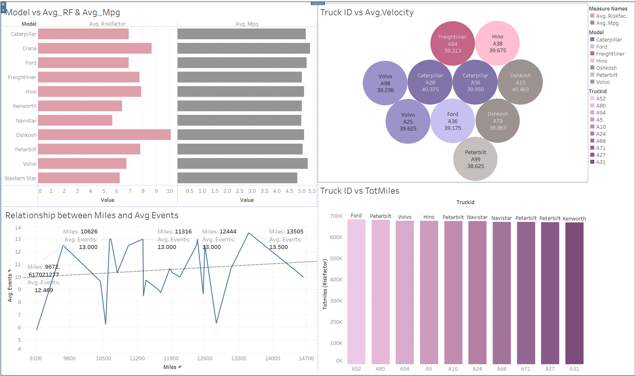
Truck Model Analysis
After the first 10,00 miles, it s better to service the truck for every 1,500 miles to keep our average number of events below 10.

Slide 7
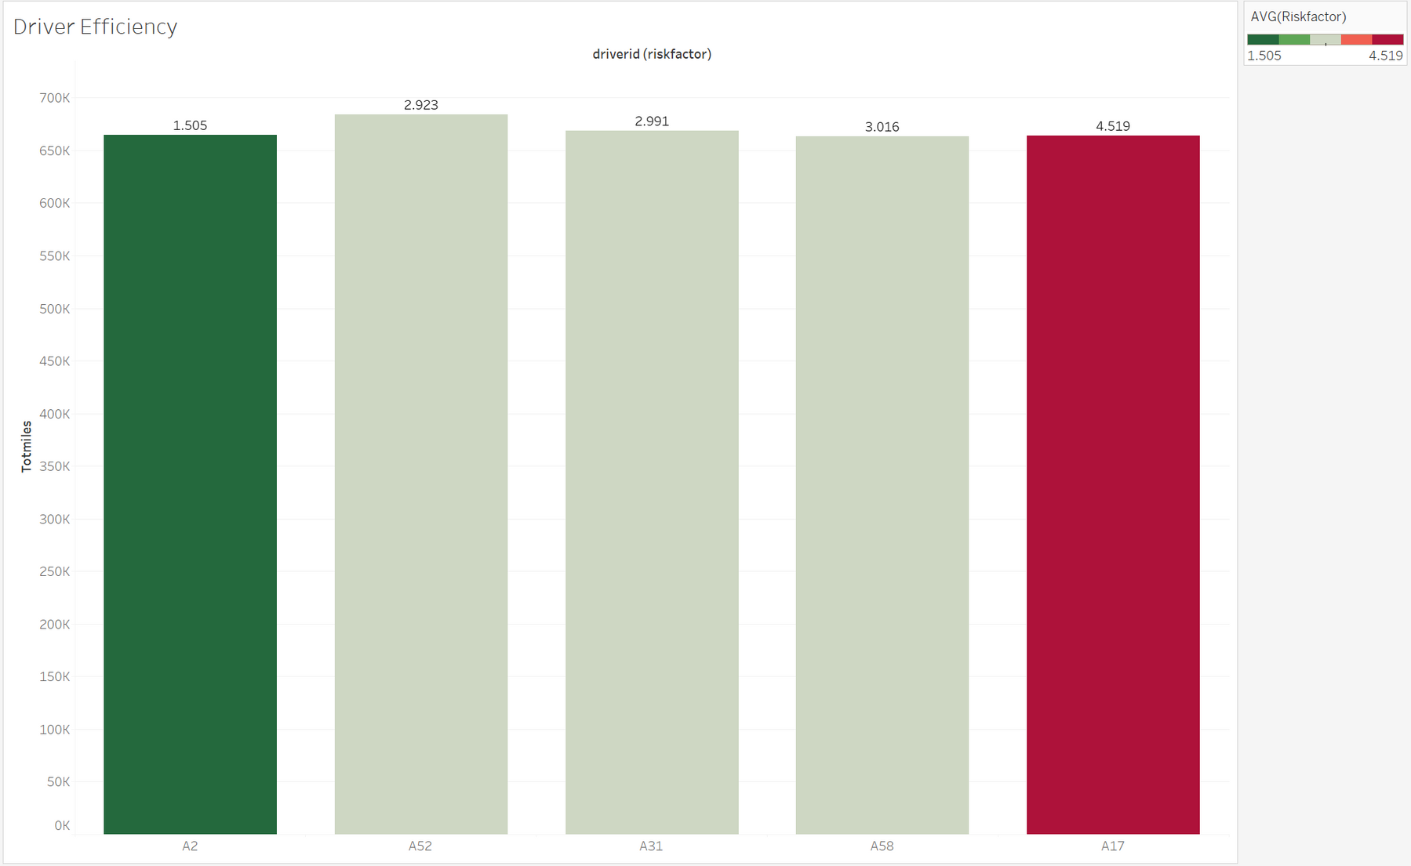
Top Performers with High Mileage and low Riskfactor
These drivers are able to cover long distances while minimizing risky driving behaviors, such as speeding, harsh braking, or unsafe lane changes.

Slide 8
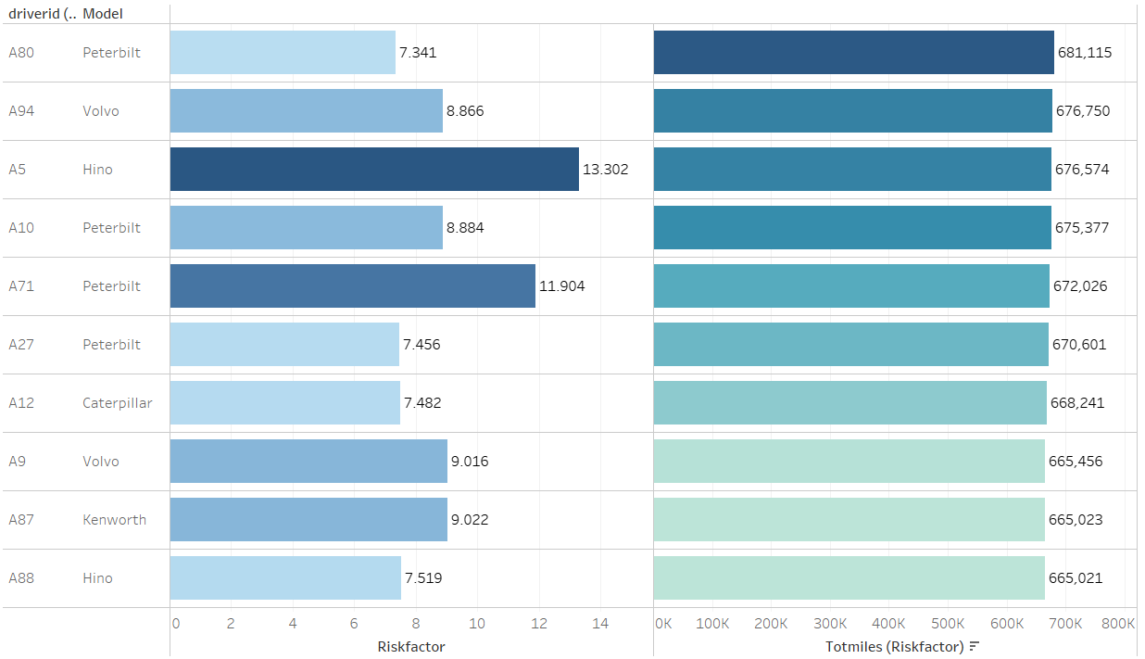
Drivers with Top Miles and their Riskfactor
ID’s with high Riskfactor are likely those exceeding the mileage/speed risk criteria. They pose a potentially higher risk due to the combination of risky driving behavior and extensive time spent on the road

Slide 9
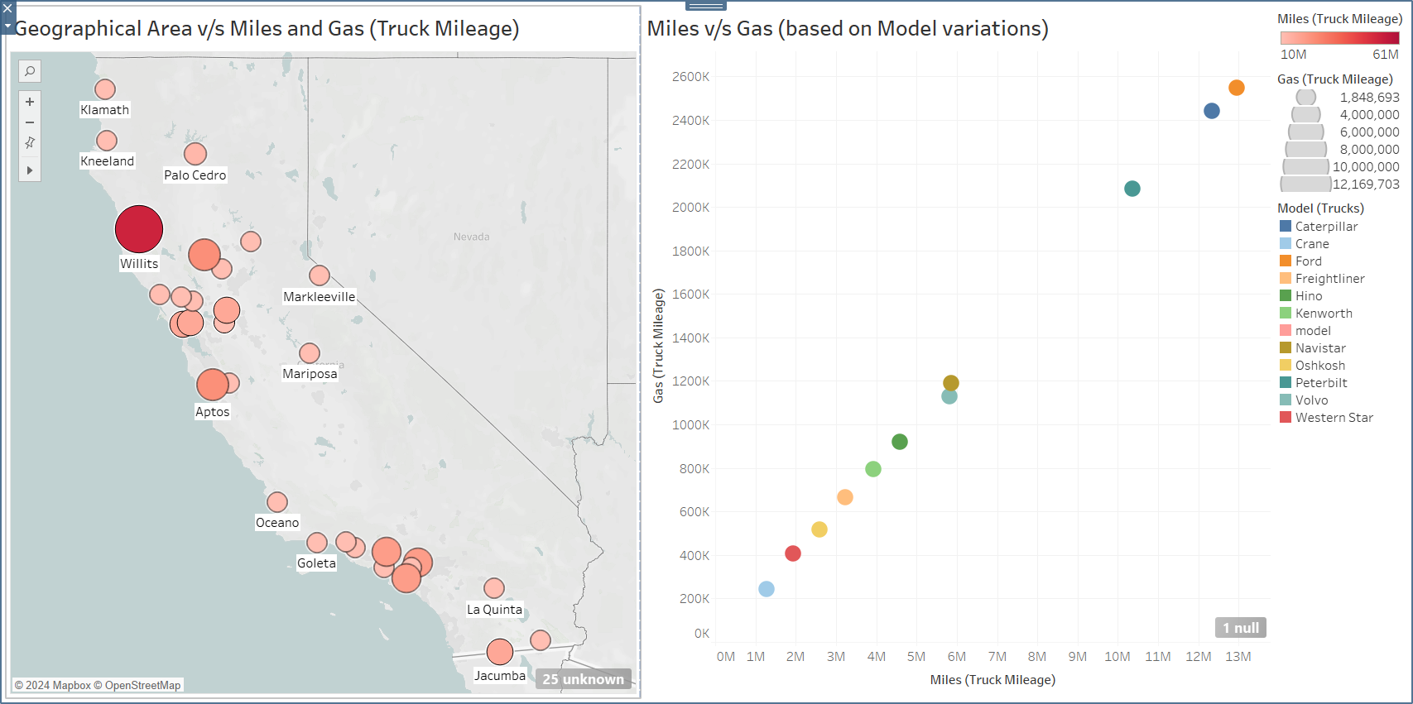
Miles and Gas - based on Demography.
Data-driven insights from geographical analysis and model comparison enable optimized transportation performance . Willits stands as a good example.

Slide 10
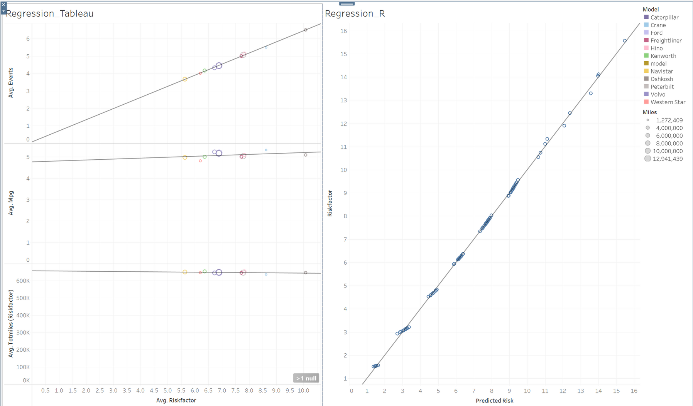
Regression
The regression model explains 99% of the variation shown in this data, therefore we will be able to get better understanding of the risk provided, we have total miles and previous events.

Slide 11
Conclusion
_______________________________________________________________
1
THE COMPANY SHOULD CONSIDER REPLACING THE TRUCKS THAT ARE AT HIGH RISK TO IMPROVE SAFETY.
2
THE RISK FACTOR FOR ACCIDENTS DEPENDS NOT ONLY ON THE DRIVER BUT ALSO ON THE MODEL OF THE TRUCK AND THE CITY WHERE IT OPERATES.
3
THE COMPANY SHOULD PAY CLOSER ATTENTION TO EVENTS BECAUSE OUR ANALYSIS HAS SHOWN THAT THEY ARE ONE OF THE REASONS FOR THE HIGH-RISK FACTOR.
4
TO MINIMIZE THE RISKS ASSOCIATED WITH DRIVING UNDER CHALLENGING CONDITIONS, IT IS RECOMMENDED TO LOWER THE SPEED OF THE TRUCKS TO IMPROVE THEIR MANEUVERABILITY AND POTENTIALLY REDUCE THE FREQUENCY OF ACCIDENTS.

Slide 12


THANK YOU

